Slide 1
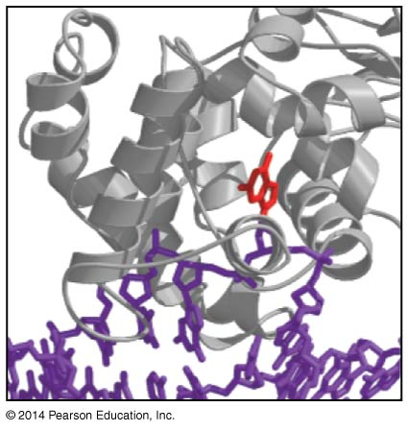
The Mutability & Repair of DNA
BT 451
Chapter 10

Slide 2
Introduction
High level of accuracy in DNA synthesis (1 mistake in 10¹⁰)
Base-pair geometry & complementarity prevent mistakes to occur in 10⁵ times.
How mistakes are prevented in order to reach the high level of accuracy?

Slide 3
Topics
Types of DNA errors
SNP
Microsatellite
Transposition
Double strand break
Sources of errors
Inaccuracy of DNA replication
Chemical/radiation damage of DNA
Insertion of DNA element (transposons)
Spontaneous damage
Repair of DNA damage
How DNA is repaired quickly???

Slide 4
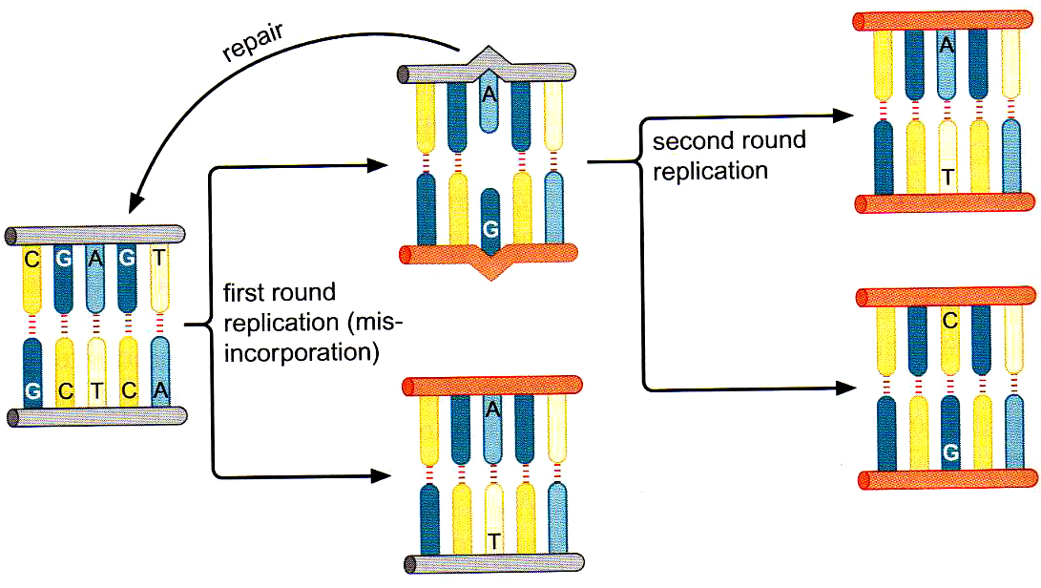
Mutation
A mismatch will be a mutation in the second round of replication
Mutation could be in coding or non-coding DNA
Notes:
Where mutations could take place?
It could be on any gene and in this case it will affect cells that transcribe this gene, and depending on where about is this mutation in the gene it would affect it, some mutations will result in abnormal non-functioning proteins other will be silent, if the mutation takes place in non coding DNA it might not affect particular gene but it might block replication or block transcription and then cause death to the cell

Slide 5
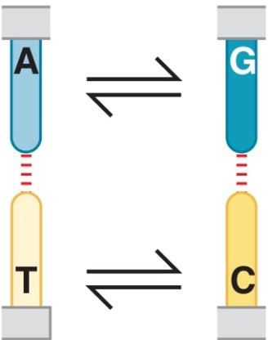
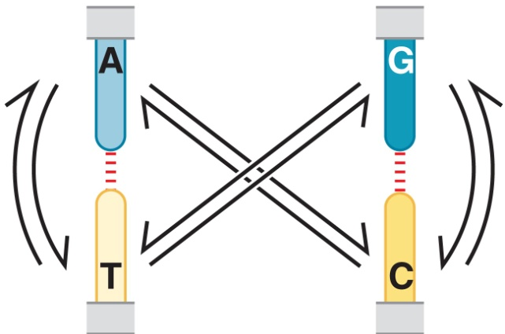
Types of DNA errors (Nature of Mutations)
Point Mutation (SNP)
Transition
Transversion
Insertion
Deletion
Notes:
Rate of new mutations arise spontaneously is 10⁻⁶ – 10⁻¹¹ per round of replication

Slide 6
Types of DNA errors (Nature of Mutations)
DNA microsatellites
Mutation-prone- sequences
Insertion/deletion of Di, tri, tetranucleotide sequence (CACACA, CGGCGGCGGCGG)
Hot spot areas for mutation
Used as physical genetic markers for mapping genetic diseases

Slide 7
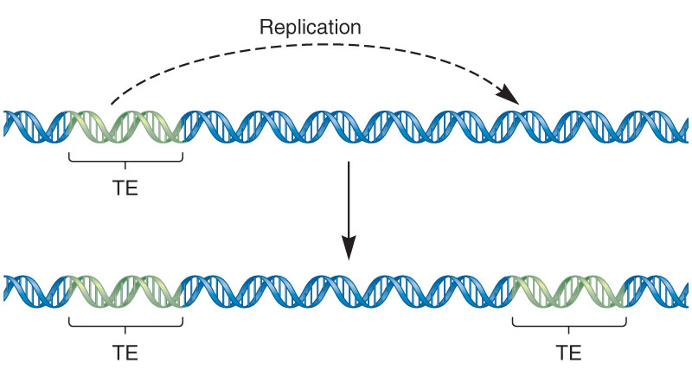
Types of DNA errors (Nature of Mutations)
Transposition

Slide 8
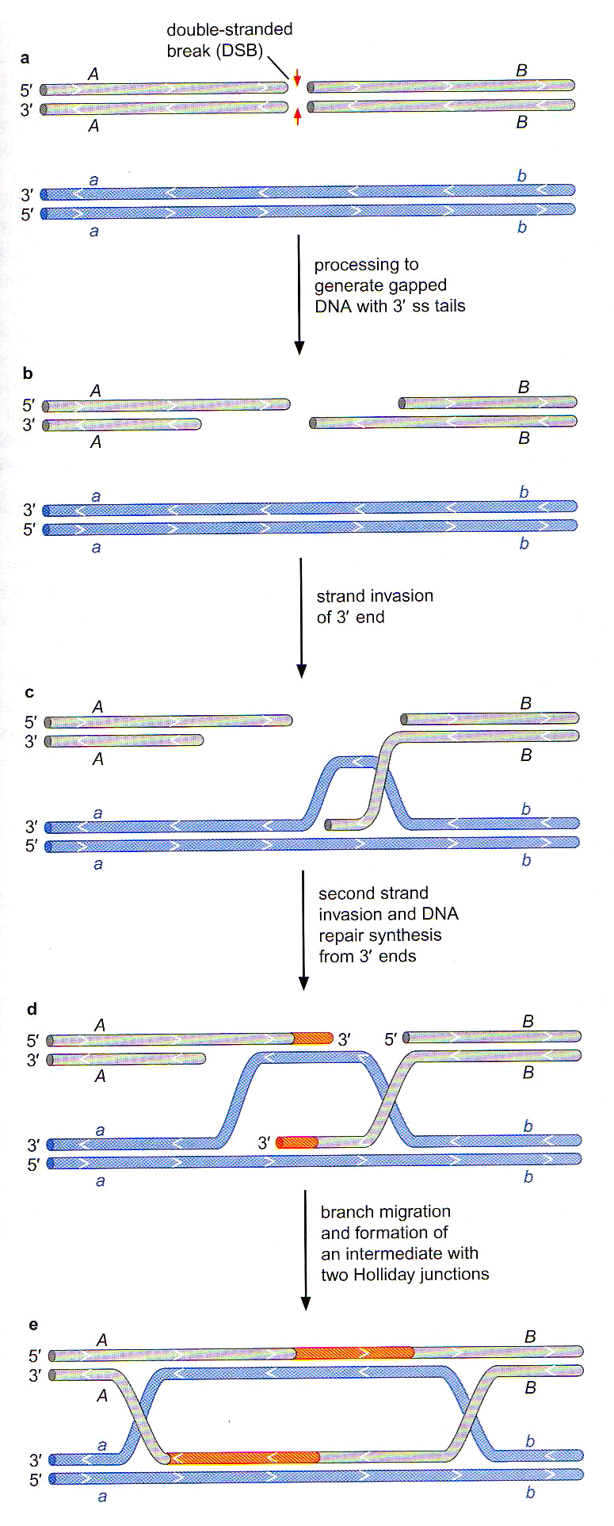
Types of DNA errors (Nature of Mutations)
4- Double strand break
Mainly caused by environmental factors
Both strands of the DNA are broken
If not repaired can lead to serious consequences

Slide 9
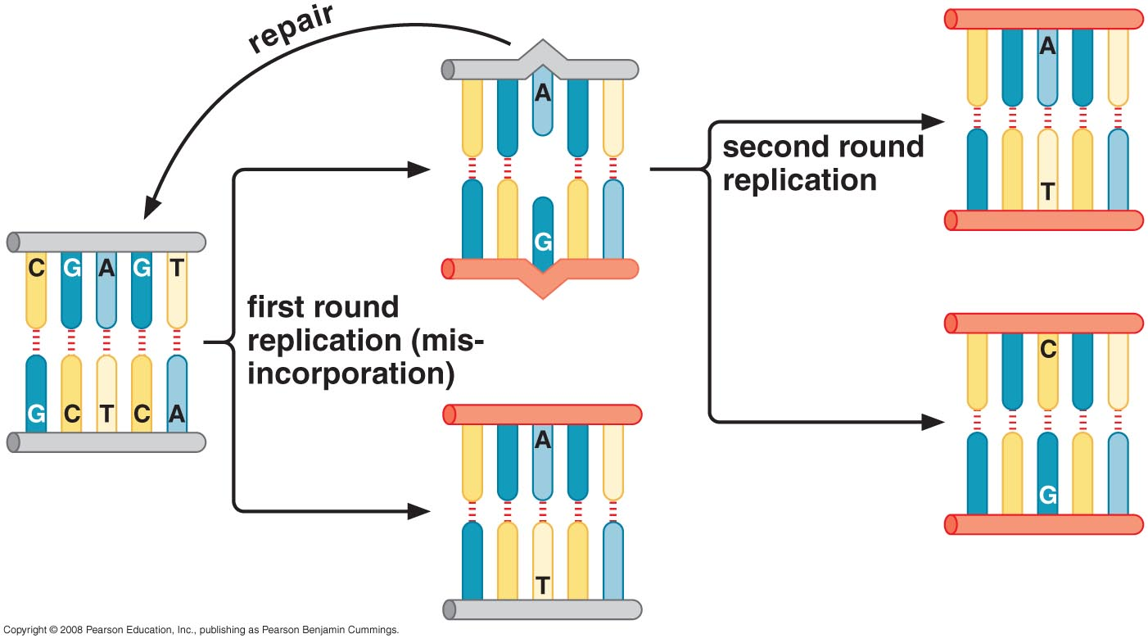
Some replication errors escape proofreading
Inability of DNA polymerase to add new bp next to wrong one
Activation of exonuclease
Notes:
Proofreading activity improves the fidelity of DNA replication by a factor of 100
Three different nucleotides can be misincorporated opposite each of the four kinds of nucleotides in the template strand e.g T, G, C opposite to a T in the template for a total of 12 possible mismatches (T:T, T:G, T:C

Slide 10
Mismatch Repair System removes errors that escape proofreading
MRS Challenge
Scan the genome to detect errors
Fix these errors accurately before the second round of cell division
MRS in E.coli : mismatch repair protein is MutS , a dimer that recognizes the mismatch from the distortion of the DNA

Slide 11
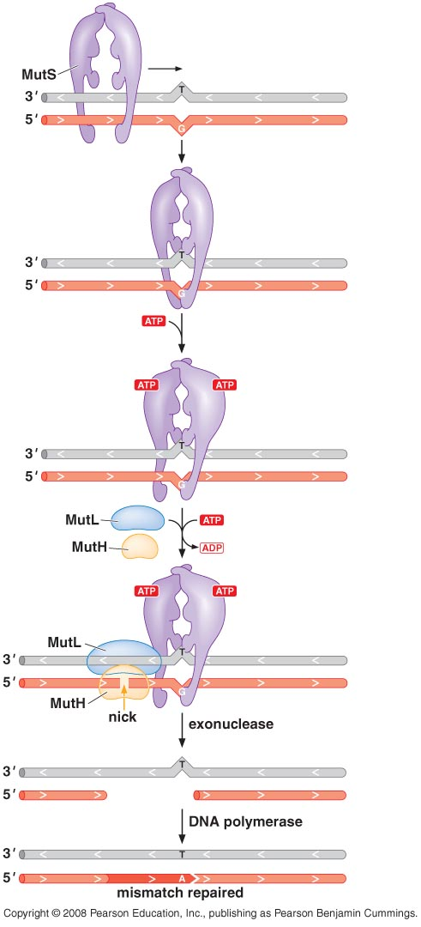
MutS Scan DNA
Recognize mismatch
Recruit MutL
Activate MutH
Helicase (UvrD)
exonucleases
Enzyme create an incision
Polymerase III
Ligase

Slide 12
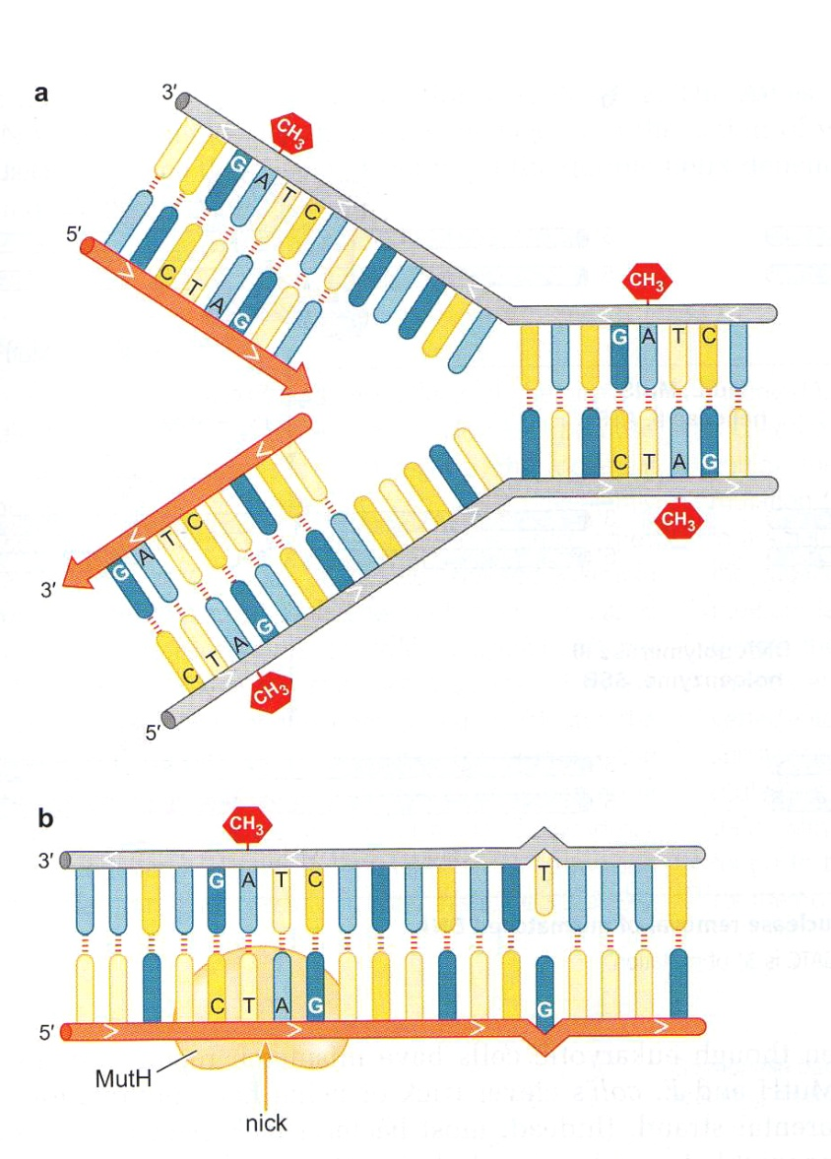
How can MRS recognize which nucleotide is the mismatched one?
E.coli tags the parental strand by transient hemimethylation
Dam methylase: methylate A residues on both strands of the sequence 5’GATC3’
This sequence is widely distributed along the entire genome and all of these sites are methylated by the Dam methylase
MutH binds to nonmethylated sites but become activated when binds to MutS and MutL

Slide 13
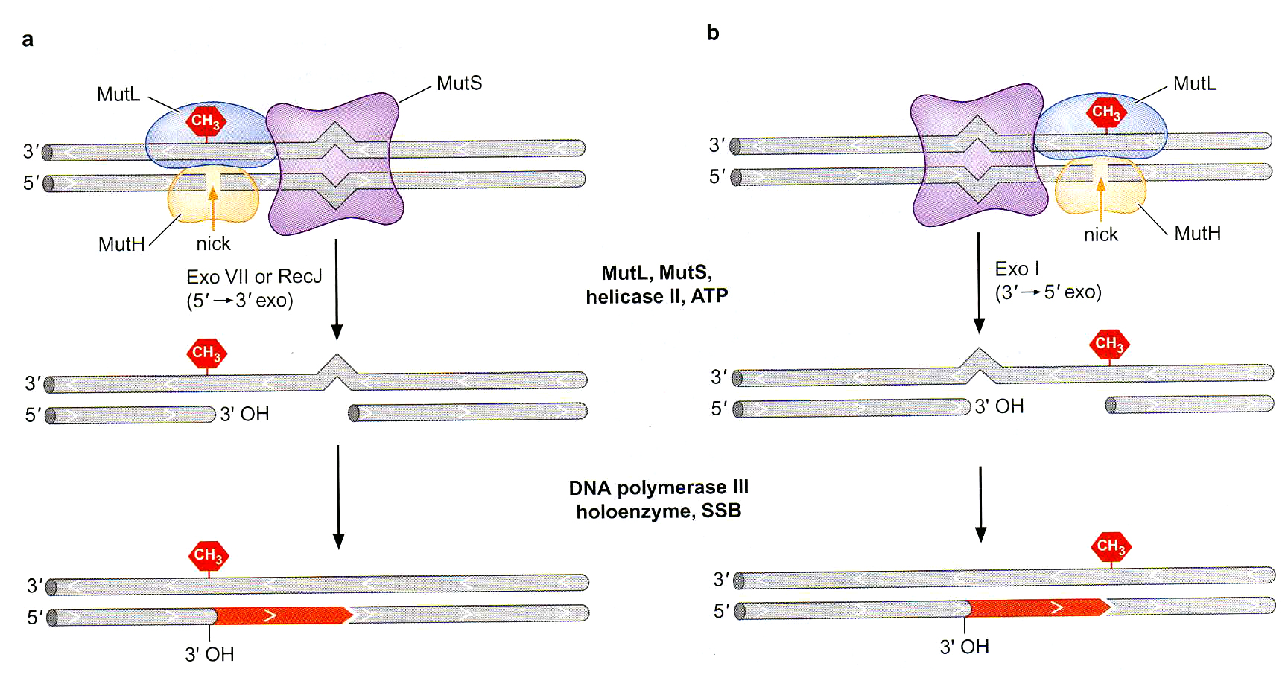
Directionality in mismatch repair: Exonuclease removal of mismatched DNA
Notes:
Endonuclease activity of Mut H becomes active only when it become in contact with Mut L and Mut S

Slide 14
Eukaryotic MRS
MutS & MutL homologs are used (MSH, MLH and PMS)
Multiple MutS like proteins with different specificities
They lack the MutH and hemimethylation trick used by E.coli
Lagging strand synthesis: prior to the ligation step, the Okazaki fragment is separated from previously synthesized DNA by a nick, which can be thought of as being equivalent to the nick generated by the MutH on the newly synthesized strand
Human homolog of MutS (MSH) interact with the sliding clamp component of the replisome and would be recruited to the site of discontinuous DNA synthesis on the lagging strand. This interaction could recruit mismatch repair system
Notes:
Some mutS are specific for SNPs other for microsatellite slippage,
Abnormal MSH gene cause heriditary non-polyposis colorectal cancer

Slide 15
Mismatch repair system in Eukaryotics
E. coli
MutS
MutL
Eukaryotics
MSH
(MutS homolog)
MLH or PMS
Hereditary nonpolyposis colorectal cancer
(mutations in human homologes of Muts and MutL)

Slide 16
Sources of errors
Spontaneous damage
Environmental factors
Inaccuracy of DNA replication
Insertion of DNA element (transposons)

Slide 17
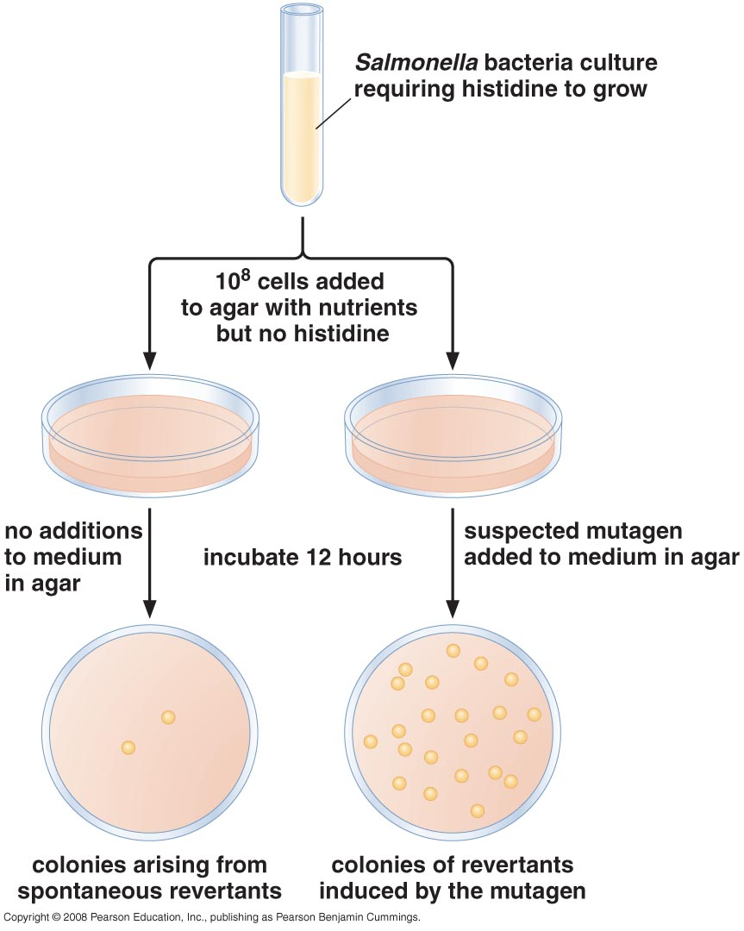
Ames test for mutagens

Slide 18
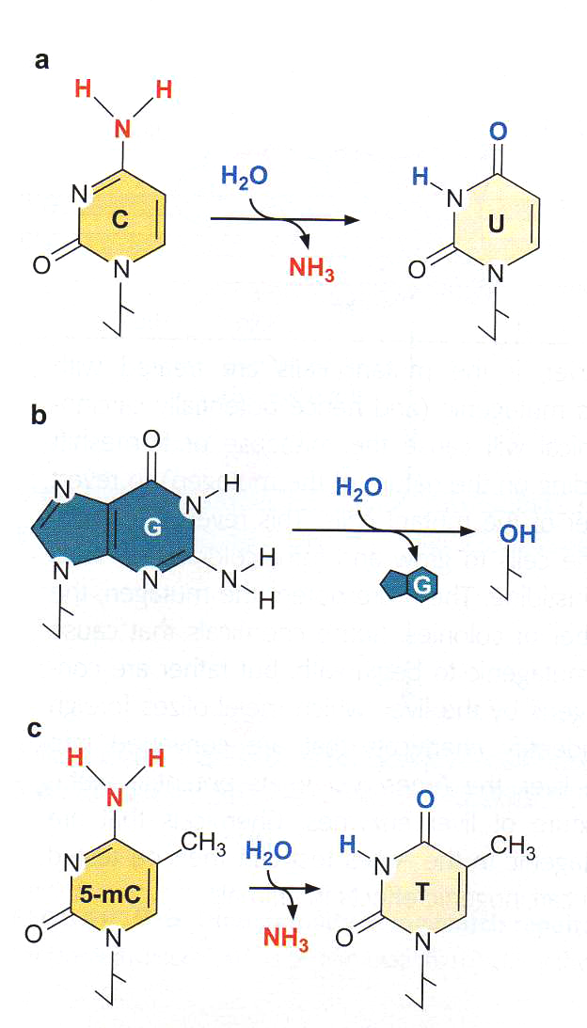
1. Spontaneous Damage A- damage caused by water (hydrolysis)
Deamination of C → U
Deamination of A → hypoxanthine
can H-bond to C
Deamination of G → xanthine can H-bond
to C (two H-bonds)
Methylated C are hotspots for spontaneous mutations in vertebrate DNA

Slide 19
Depurination
Hydrolysis of N-glycosyl linkage → abasic site (apurinic)

Slide 20
2. Damage caused by environmental factors
Alkylation
Oxidation
Radiation
UV light
Gamma ray
X ray

Slide 21
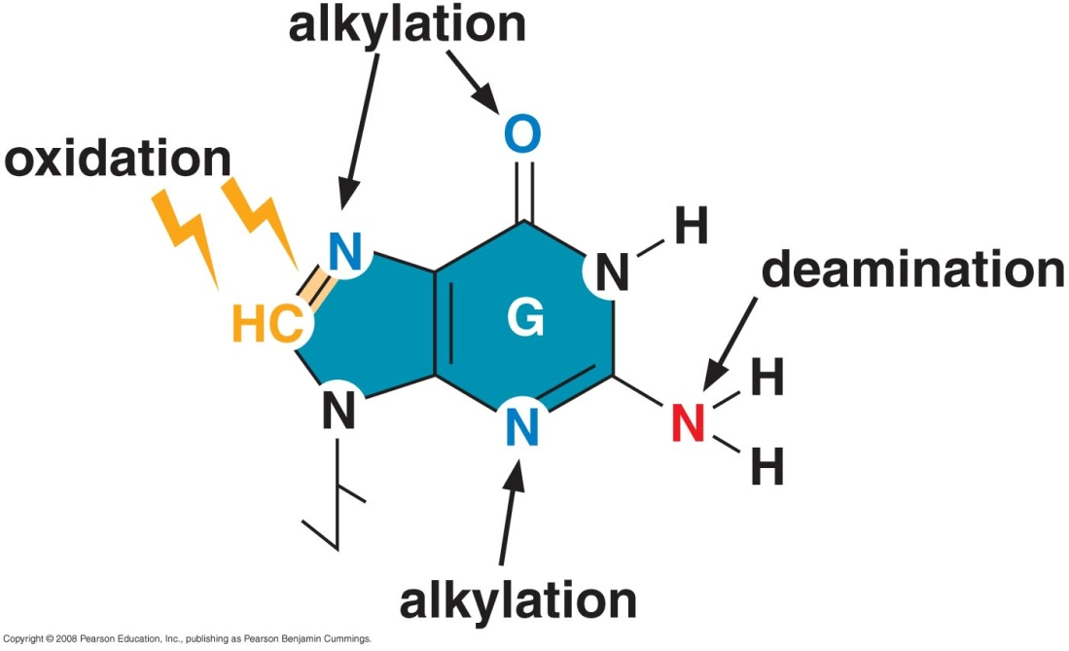
2. Damage caused by environmental factors A- Alkylation
Methyl/Ethyl group added to base or DNA backbone
Nitrosamines and N-methyl-N¹-nitrosoguanidine
O atom of guanine C6 → O⁶-methylguanine T

Slide 22
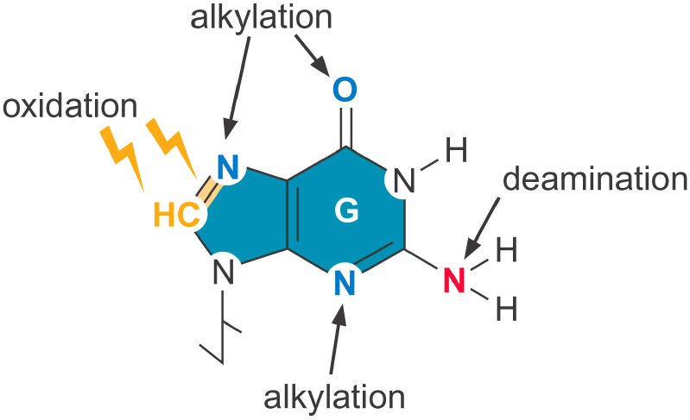
Damaged by alkylation and oxidation
Alkylation at the oxygen of carbon atom 6 of G : O⁶-metylguanine, often mispairs with T.
Oxidation of G generates oxoG, it can mispair with A and C. a G:C to T:A transversion is one of the most common mutation in human cancers.

Slide 23
2. Damage caused by environmental factors B- Oxidation
Ionizing radiation or chemicals producing free radicals
Caused by oxidizing agents (O₂–, H₂O₂, OH•)
Oxidation of guanine → oxoG A
This transversion is very common in cancer
C

Slide 24
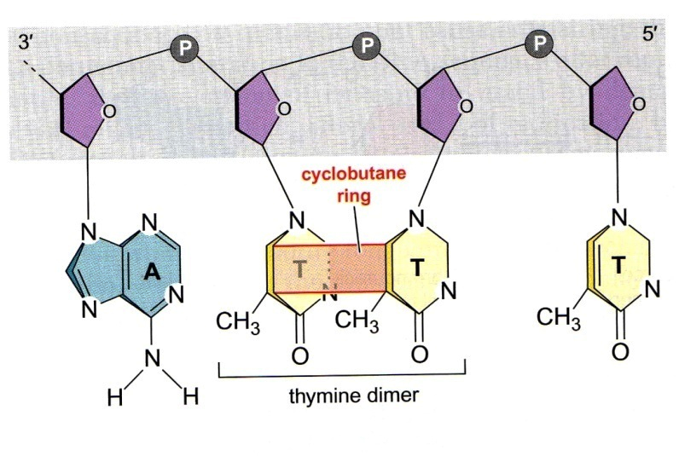
2. Damage caused by environmental factors C- UV radiation
Two adjacent pyrimidines (T/C) join together
Photochemical fusion cause DNA polymerase to stop

Slide 25
2. Damage caused by environmental factors D- gamma & X-ray radiation
Gamma radiation used for gamma camera & gamma knife
X ray used to radiograph bone to detect fractures /deformity
Cause double strand break by ionizing DNA backbone
Also it forms free radicals
Cell can’t divide when chromosomes are broken → apoptosis
Used for chemo/radio therapy
Clastogenic: ionizing radiation and agents like bleomycin that cause DNA to break

Slide 26
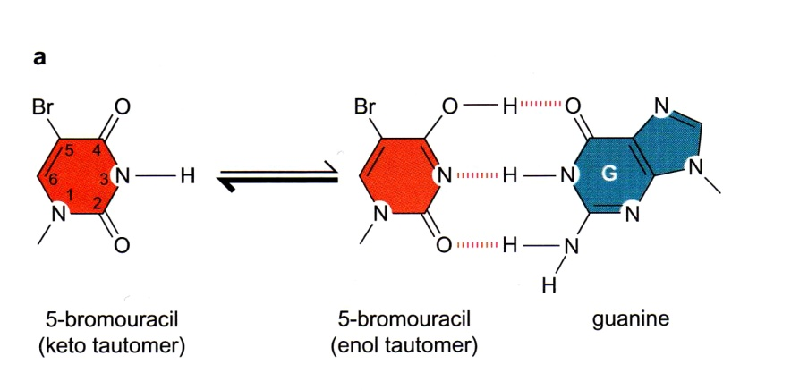
Damage caused by base analogs
T analog
Structurally similar to the base that can be taken by the cell and incorporated with DNA

Slide 27
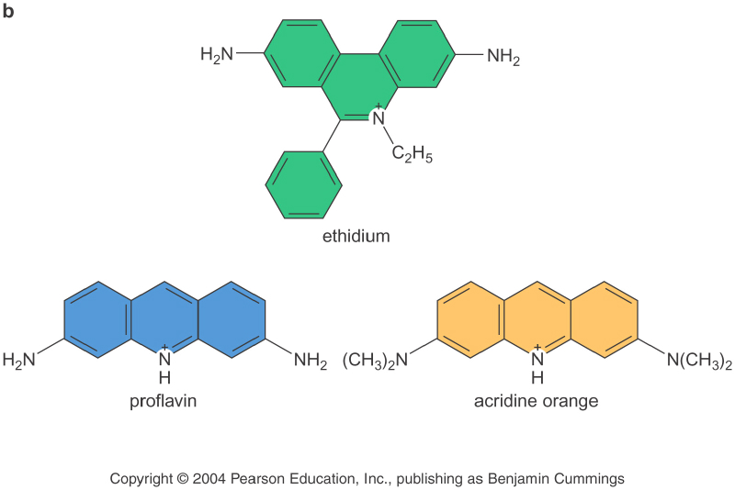
Mutations caused by intercalating agents
Intercalating agents
flat molecules
Causing addition or deletion of bases during replication

Slide 28
Spontaneous Damage damage caused by intercalating agents
Flat molecules of polycyclic rings bind to DNA
Proflavin, acridine and ethidium
Cause insertion/deletion of one or a few bp
How? Skipping or addition of new bp.
In case of insertions , by slipping between the bases in the template strand, these mutagens cause DNA polymerase to insert an extra base opposite the intercalated molecule
In case of deletion, the distortion to the template caused by the presence of an intercalated molecule might cause the polymerase to skip a nucleotide
Serious consequence on translation of mRNA

Slide 29
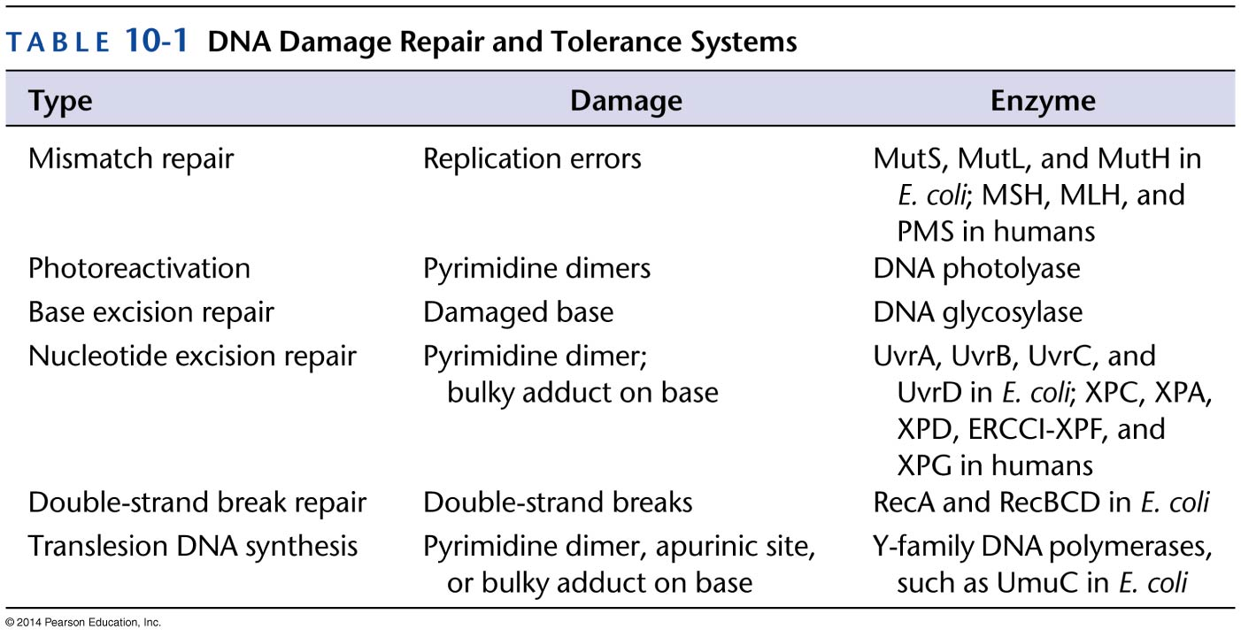
DNA Repair
G1 & G2 are check points before replication and division
Cell aim to repair any damage to pass to M phase
In all previous methods template DNA was available

Slide 30
Repair of DNA Damage: DNA repair system
Excision repair systems: the damaged nucleotide is not repaired but removed from the DNA, the other undamaged strand serves as a template for reincorporation of the correct nt by DNA polymerase
Recombination repair: both strands are damaged. Sequence information is retrieved from a second undamaged copy of the chromosome.

Slide 31
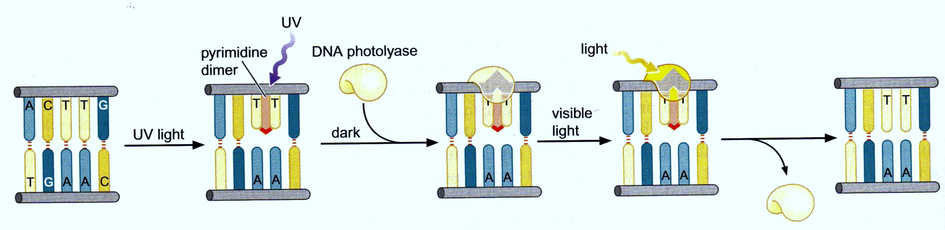
1- Direct reversal of DNA damage
Repair of damage caused by UV radiation photoreactivation

Slide 32
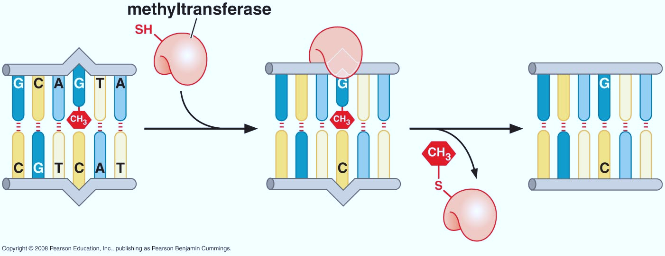
1- Direct reversal of DNA damage
O⁶-methylguanine is repaired directly by methyl transferase.

Slide 33
2- Repair of hydrolysis damage base excision repair system
Glycosylase enzyme
Recognize damaged base
hydrolyze glycosidic bond
Repair is completed by Pol & ligase
Different specificities (11 different ones in human)

Slide 34
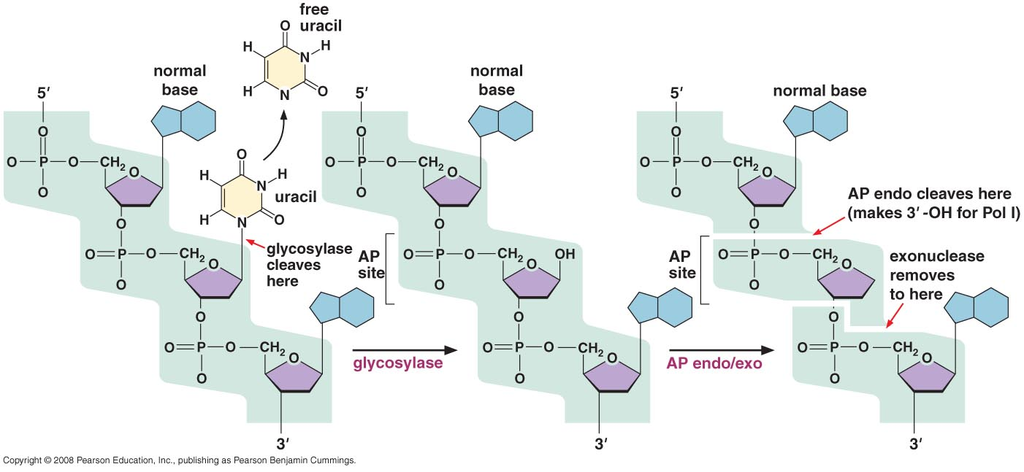
Base excision pathway: The uracil glycosylase reaction

Slide 35
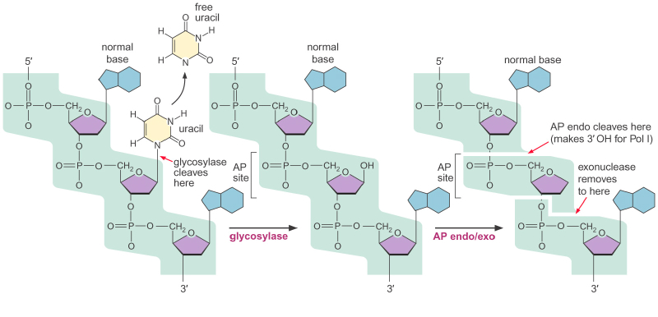
Base excision repair
DNA glycosylases are lesion-specific and cells have multiple DNA glycosylases
1. Uracil glycosylase
2. Another specific glycosylase is responsible for removing oxoG
AP: apurinic or apyrimidinic

Slide 36
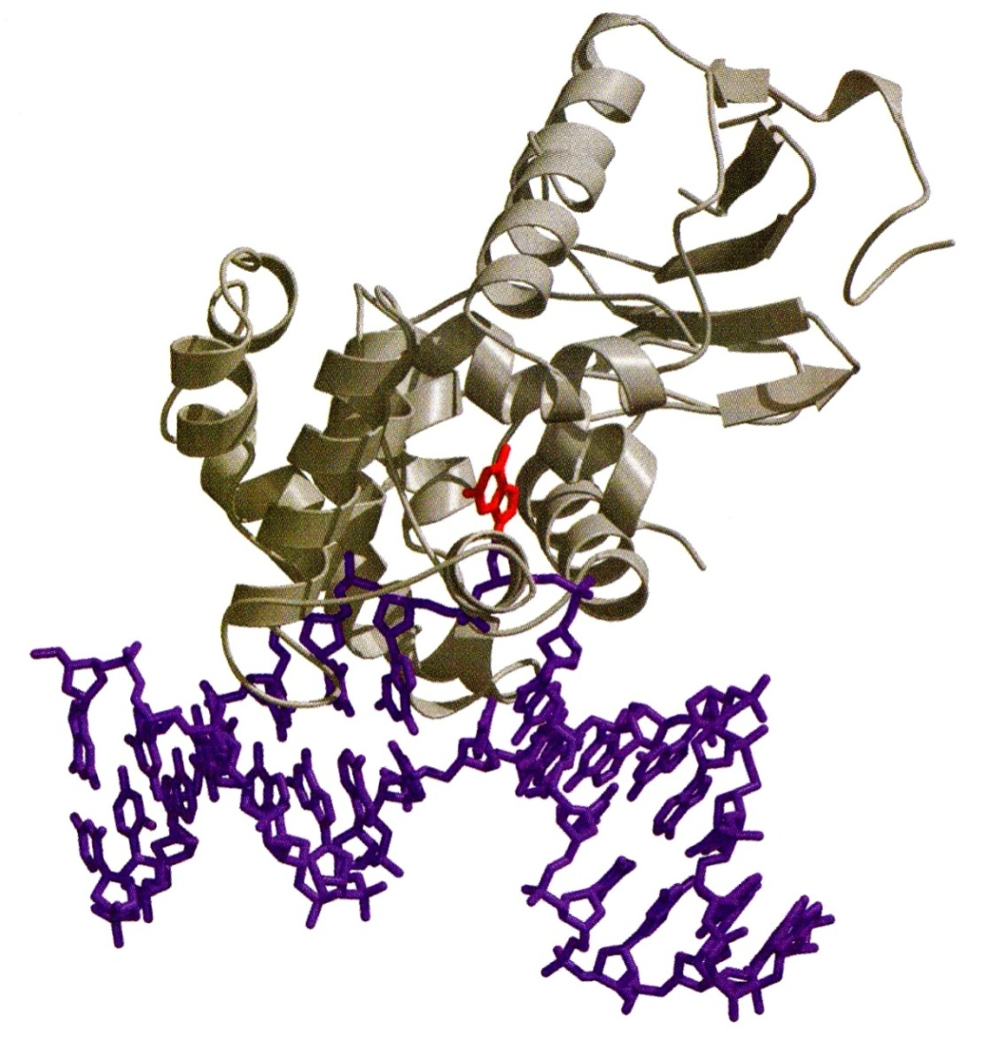
How can Glycosylase complex recognize abnormal base?
Evidence indicates that these enzymes Diffuse laterally along the minor groove
of DNA until a specific lesion is detected
Damaged base is flipped out

Slide 37
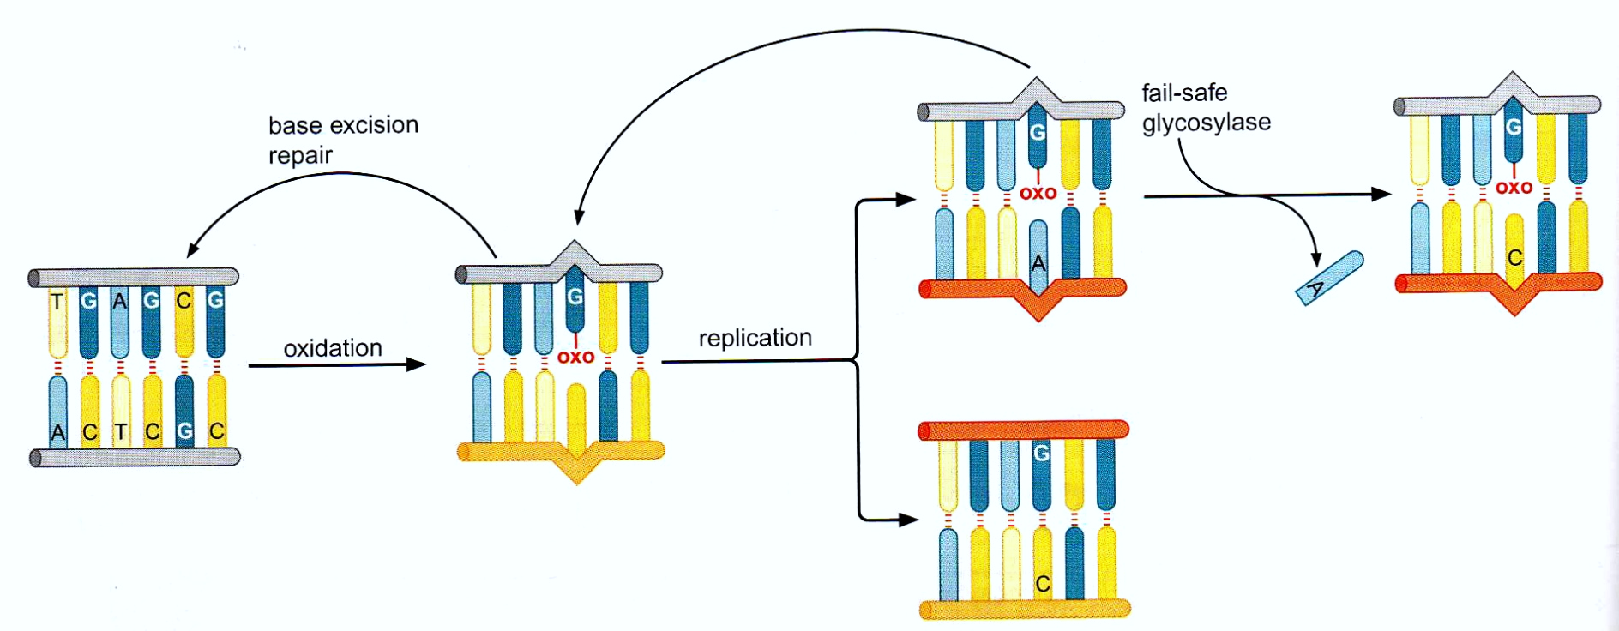
Fail-safe glycosylase oxoG: A reapir
Works in case glycosylase did not recognize the error before replication
Fail-safe system that removes T opposite a G (arise from deamination of 5-mehylcytosine

Slide 38
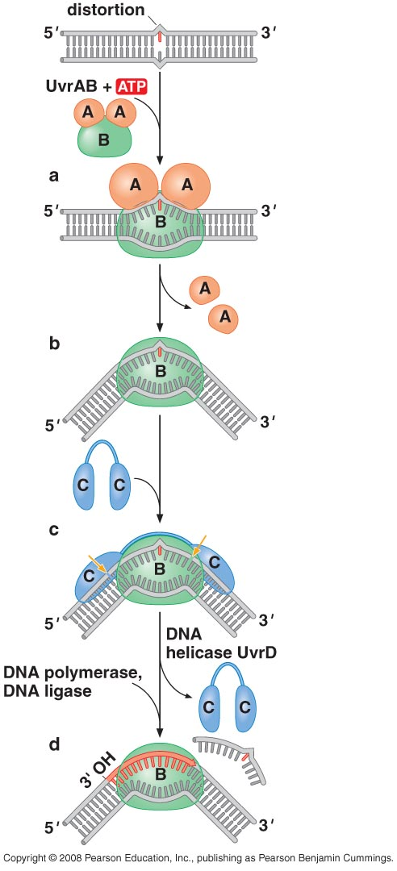
3- Nucleotide excision repair (NER) cleaves damaged DNA on either side of the lesion
Recognize DNA distortion (T dimers or bulky adduct on a base)
Short single-stranded segment is removed
4 proteins involved in E.coli:
UvrA
UvrB
UvrC
UvrD
Notes:
8 nucleotides away on the 5’ side
4-5 nucleotides away on the 3’ side
12-13 nucleotide long

Slide 39
The principle of NER in higher cells is much the same as that in E.coli but more complicated
XPC (detect distortion of DNA like UvrA)
Formation of bubble involves the helicase activities of proteins XPA and XPD (equivalent of UvrB in E.coli) and the SSB protein RPA.
The bubble creates cleavage sites on the 5’ side of the lesion for a nuclease ERCC1-XPF on the 3’ side for the nuclease XPG (like UvrC)
Resulting ssDNA segment is 24-32 nucleotide long.

Slide 40
Nucleotide excision repair enzyme
UVR proteins recognize broad variety of changes including dimmers caused by UV
Mutants to UVR proteins are sensitive to UV light
Xeroderma pigmentosum (7 XP genes)

Slide 41
Nucleotide Excision Repair
The principles of nucleotide excision repair in higher cells is much the same as in E. coli but us moer complicated, involving 25 or more polypeptides.
The UVR proteins are needed to mend damage from UV light; Mutants of uvr genes are sensitive to UV light, and lack the capacity to remove T-T or T-C adducts.
In human, xeroderma pigmentosum patients have mutations in seven genes (XP genes).
These XP proteins are corresponding to proteins involved in
nucleotide excision repair.

Slide 42
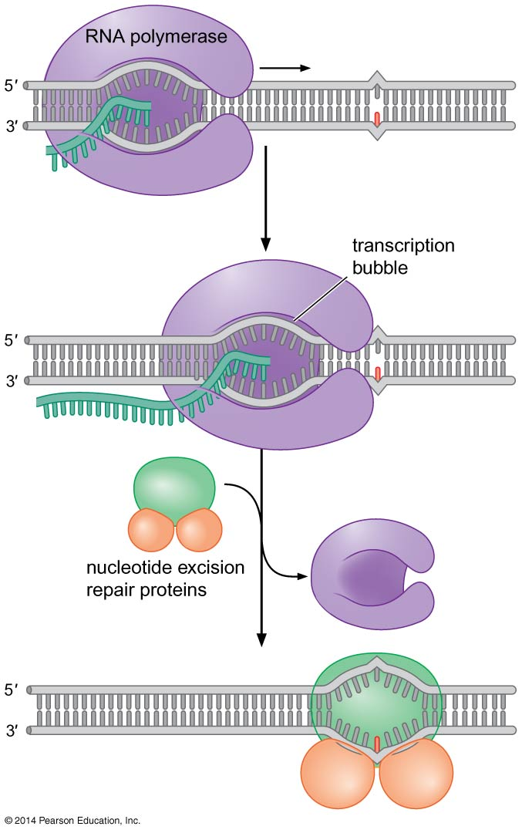
4- Transcription- coupled repair
RNA polymerase serve as damage sensing protein
Stop RNA polymerase and call nucleotide excision repair proteins
Has the advantage of focusing on genes being transcribed

Slide 43
Transcription - coupled repair in Eukaryotes
TFIIH
Includes XPA & XPD subunits
Unwind DNA template during transcription
Melt the DNA around the lesion during nucleotide excision repair/ transcription coupled repair

Slide 44
5- Double strand break (DSB) repair . Recombinational repair
Both strands are broken (no template)
Sister chromosome is a template
Helps repair errors in DNA replication

Slide 45
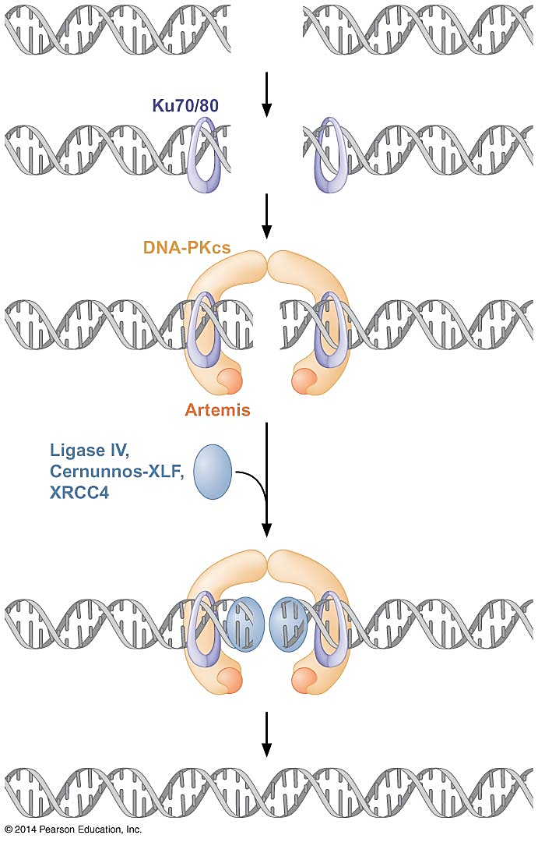
What happens if the break took place before replication (no sister chromosome)?
Fail safe method nonhomologous end joining (NHEJ), a backup system in yeast
Two broken DNA ends joined together.
Because the sequence information is lost from the broken ends, the original sequence is not restored (its mutagenic but less hazardous to the cells than unrepaired broken ends)
7 components found in mammalian cells:
Ku70, Ku80, DNA-PKcs, Artemis, XRCC4, Cernunnos-XLF, and DNA ligae IV
Ubiquitous in eukaryotic cells, les frequent in bacteria
Not efficient method except in spores of B. subtilis (has a two-protein NHEJ system that repairs DNA breaks when the spore germinates)

Slide 46
6- Translesional DNA synthesis
Translesion synthesis is catalyzed by a specialized class of DNA polymerases that synthesize DNA directly across the site of the damage.
In E. coli, DNA Pol IV (DinB) or DNA Pol V (a complex of the proteins UmuC and UmuD`) performs translesion synthesis.
DinB and UmuC are members of a distinct family of DNA polymerases found in many organisms known as the Y family of DNA polymerases
There are five translesion polymerases known in humans, four of which belong to the Y family.
Y-Family DNA polymerases: specialize in translesion synthesis, bypassing damaged bases that would otherwise block the normal progression of replication forks. Y-Family polymerases are also characterized by a low catalytic efficiency, a low processivity, and a low fidelity on normal DNA.

Slide 47
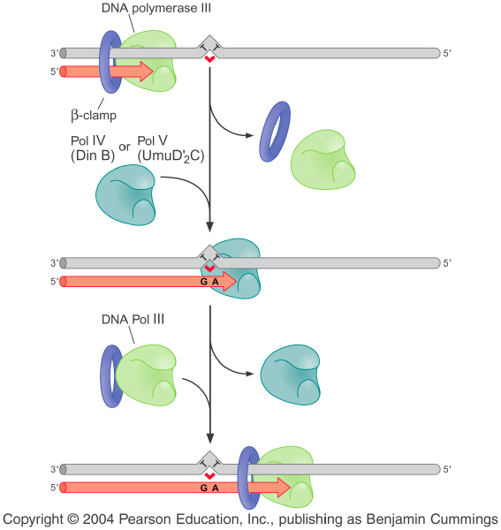
Translesion DNA synthesis: although are template dependent, the synthesis in a manner that is independent of base pairing.
obstacles to progression of the DNA polymerase
(or AP site)
Complex of proteins UmuC and D’
(Y-family of DNA polymerase)

Slide 48
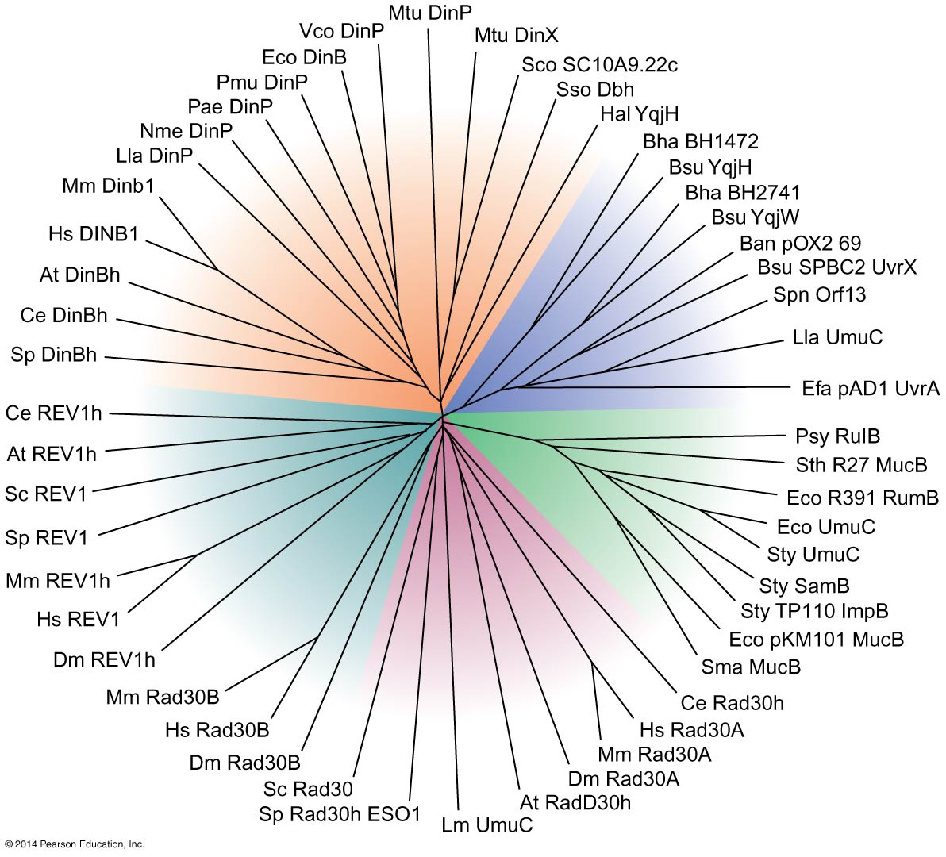
Box 10-6
Y-Family DNA polymerases
Notes:
48
Box 10-6

Slide 49
In E. coli, the translesion polymerases are not present under normal circumstances.
Rather, their synthesis is induced only in response to DNA damage.
Thus, the genes encoding the translesion polymerases are expressed as part of a pathway known as the SOS response.
Damage leads to the proteolytic destruction of a transcriptional repressor (the LexA repressor) that controls expression of genes involved in the SOS response, including those for DinB, UmuC, and UmuD, the inactive precursor for UmuD`.
Interestingly, the same pathway is also responsible for the proteolytic conversion of UmuD to UmuD`.
Cleavage of both LexA and UmuD is stimulated by a protein called RecA, which is activated by single-stranded DNA resulting from DNA damage.
RecA is a dual-function protein that is also involved in DNA recombination.

Slide 50
How a translesion polymerase gains access to the stalled replication machinery at the site of DNA damage?
In mammalian cells, entry into the translesion repair pathway is triggered by chemical modification of the sliding clamp (attachment of ubiquitin).
Once ubiquitinated, the sliding clamp recruits translesion polymerase through ubiquitin.
The translesion polymerase somehow displaces the replicative polymerase from the 3’ end of the growing strand and extends it across the site of damage.

Slide 51
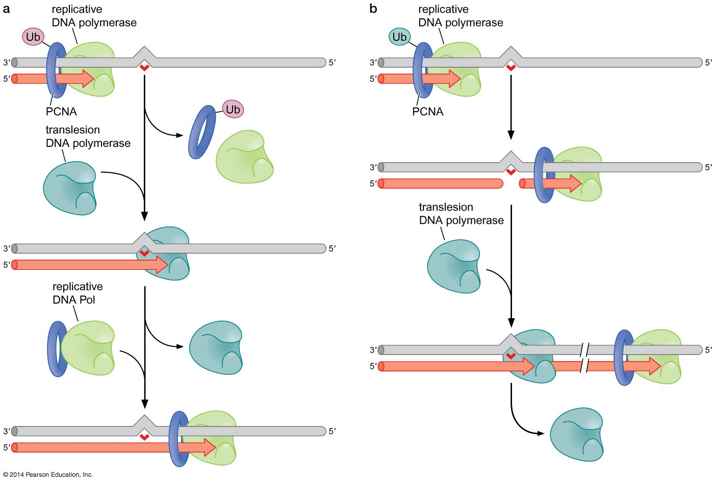
Alternative models for translesion synthesis: a- The polymerase-switching model b- The gap-filling model
Notes:
51
Figure 10-23

Slide 52
END

